Slide 1
FEDERATED LEARNING IN MOBILE WORLD
STUDENT: VENITHRAA GANESAN
MENTOR : VINCENT GIRAUDON

Slide 2
INTRODUCTION

Slide 3

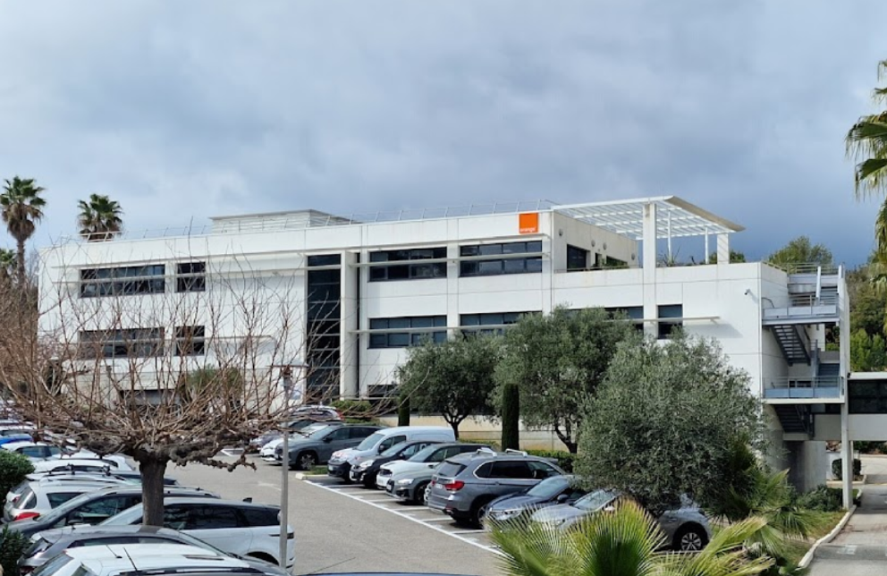
Orange Innovation
AI for Home Services

Slide 4
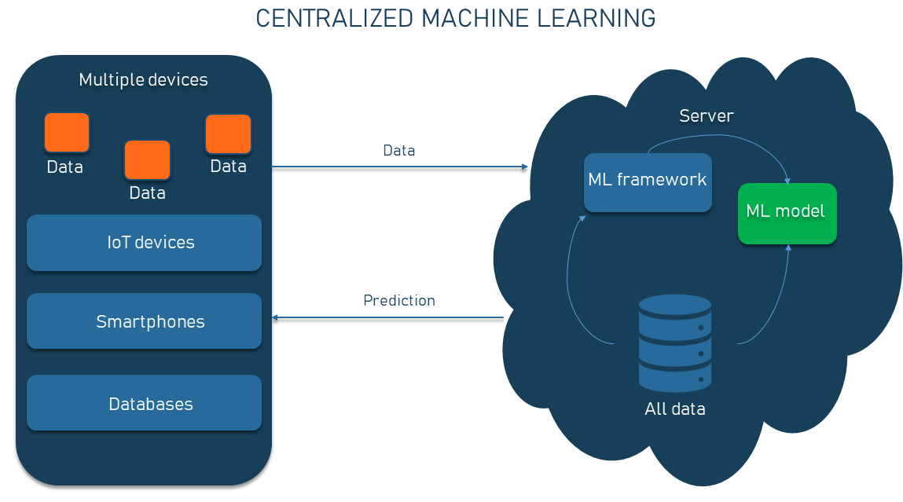
CENTRALIZED MACHINE LEARNING

Slide 5
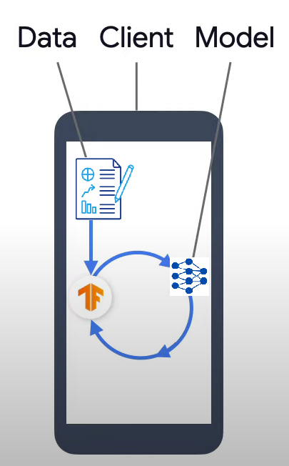
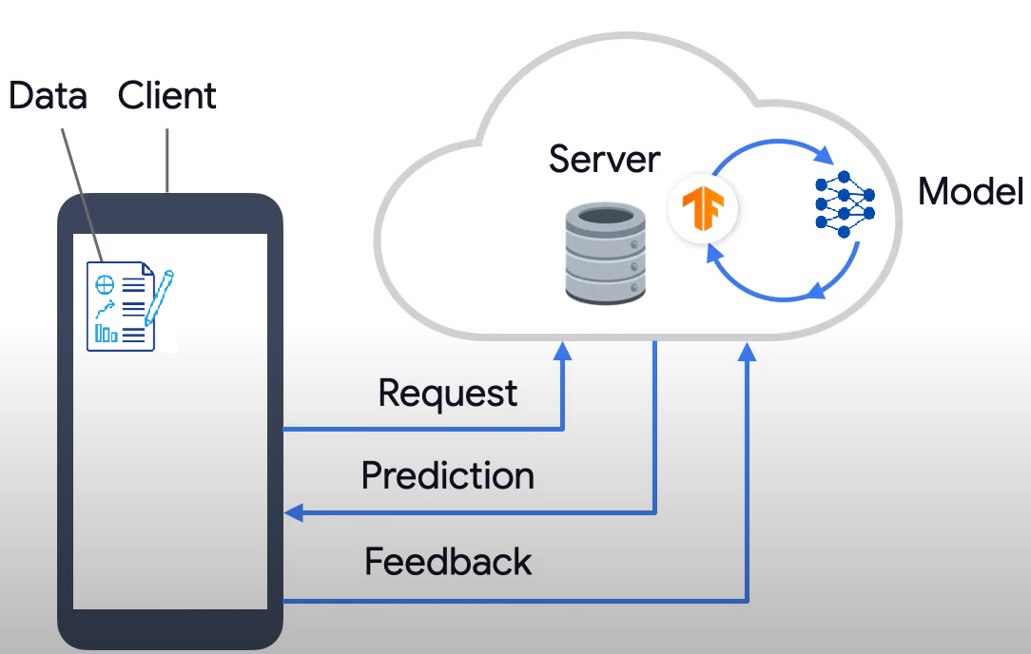
MACHINE LEARNING IN SMARTPHONE
WHAT IF WE TRAIN THE MODEL LOCALLY?

Slide 6
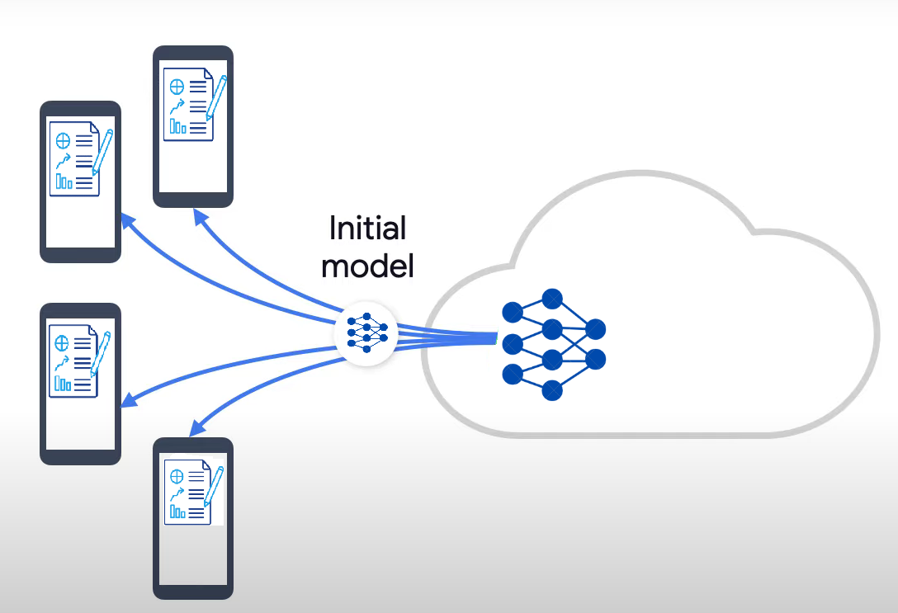
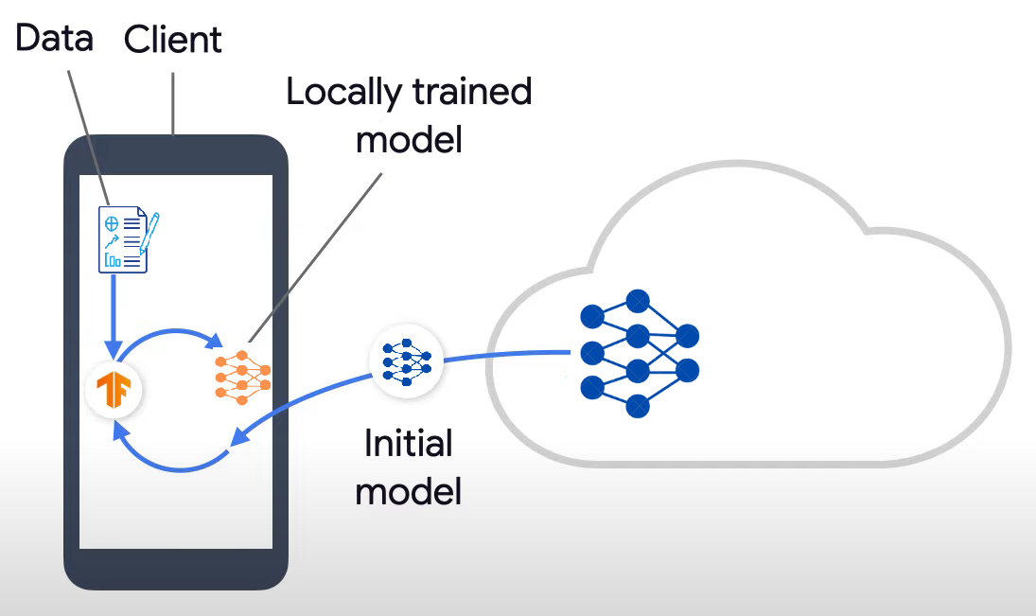
WHAT IS FEDERATED LEARNING?
1
2

Slide 7
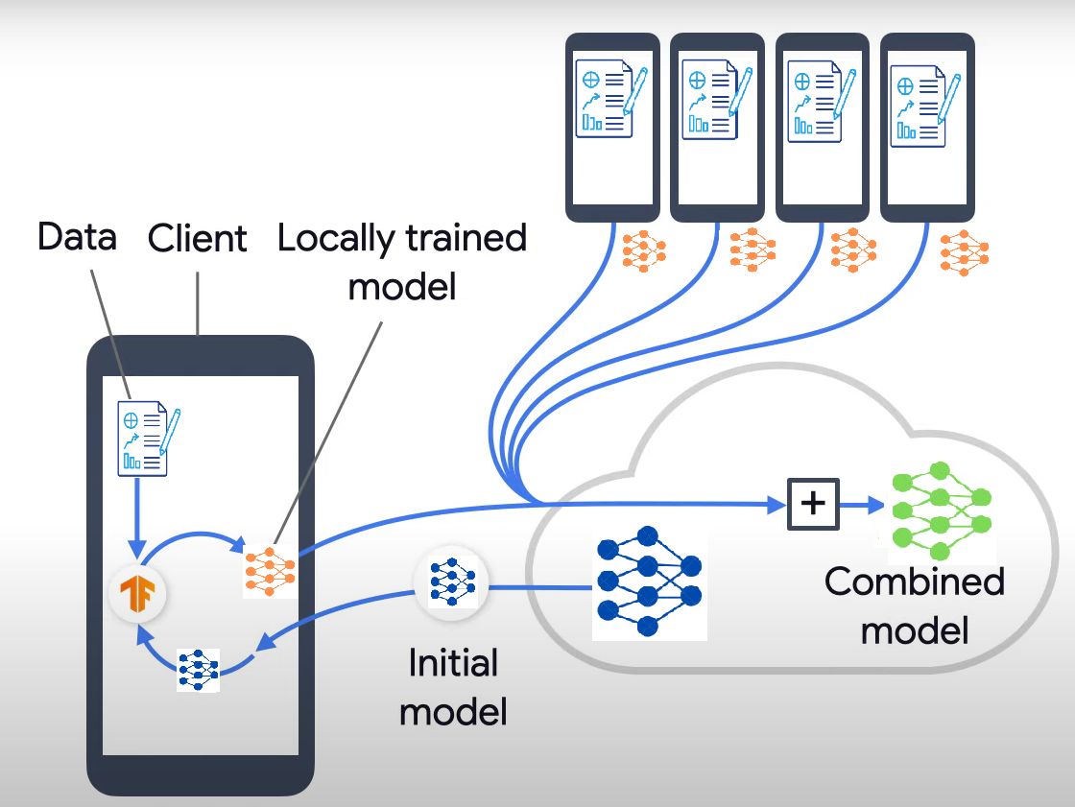
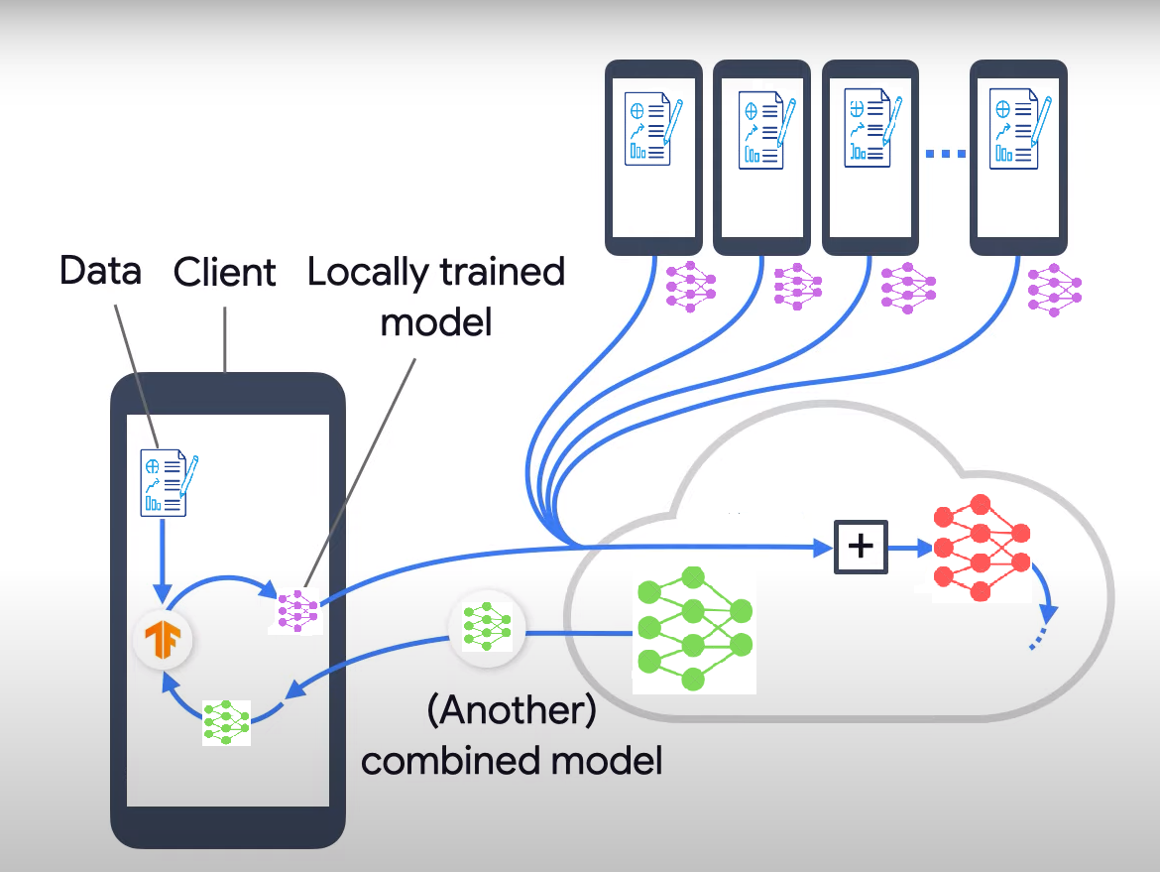
3
4

Slide 8
My journey

Slide 9
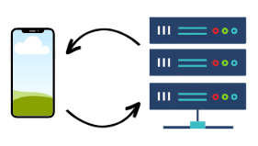

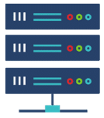
MODEL EXCHANGE
sending and receiving the model to the server
SERVER ARCHITECTURE
Aggregation of models in server side
TRAINING
training the data locally
6
7
5
DATA EXCHANGE
get/post request to the server.
4
3
RETRIEVING DATA
retrieving data and sending it to the server
PRACTICE
Creating mobile app using kotlin,
http response
SERVER SIDE
building a server using docker
2
1

Slide 10
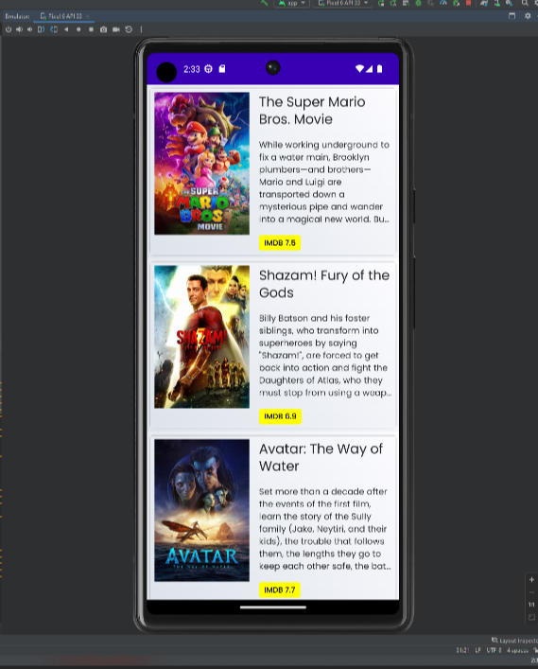

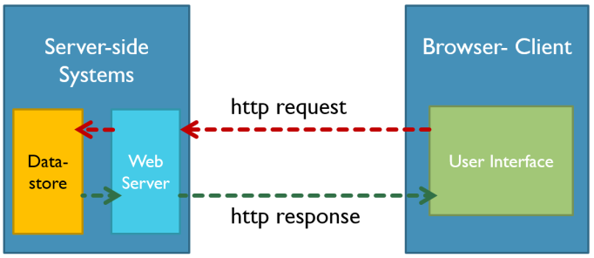
CREATE MOBILE APPLICATIONS USING KOTLIN,
HTTP RESPONSE
1

Slide 11


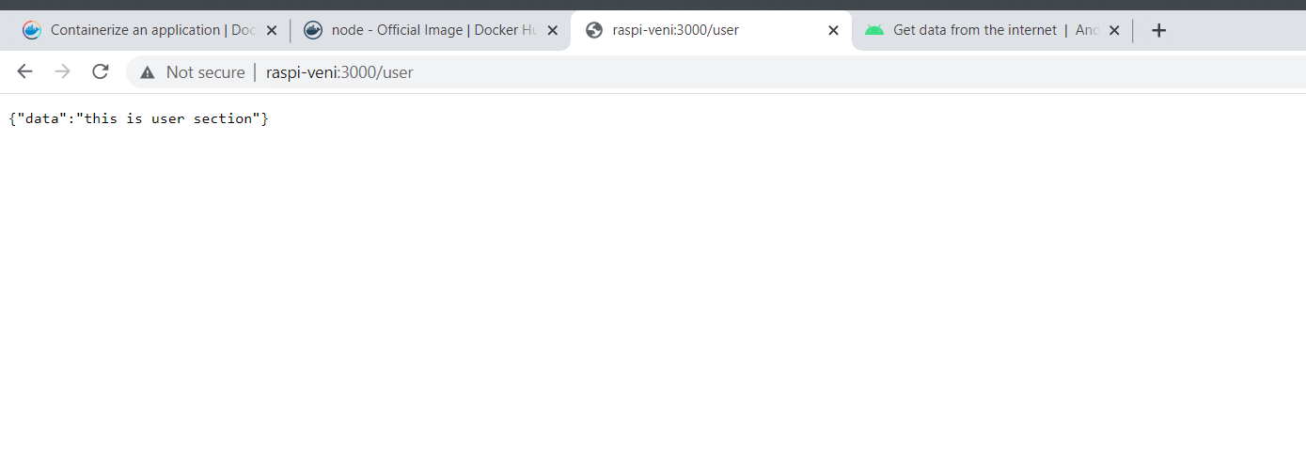
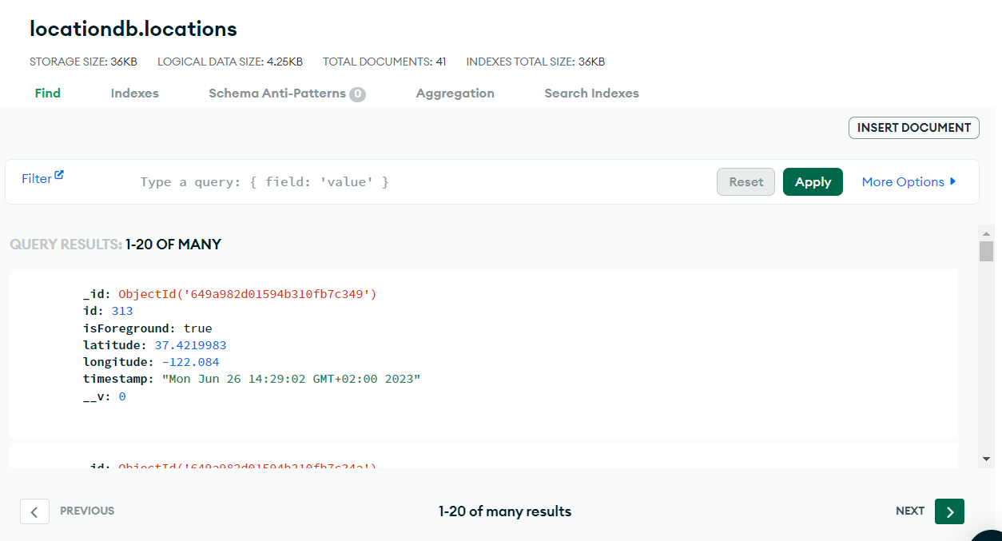
2
BUILDING A SERVER USING DOCKER

Slide 12

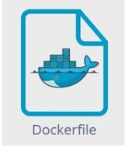

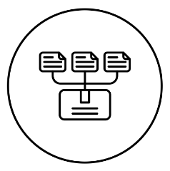
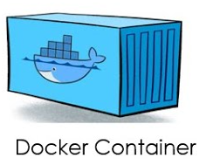

2
BUILDING A SERVER USING DOCKER
Registry

Slide 13
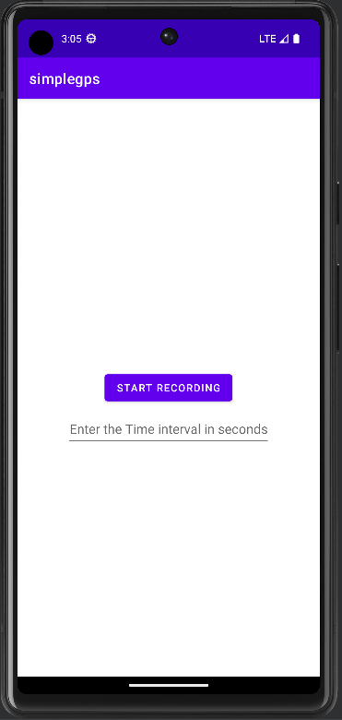




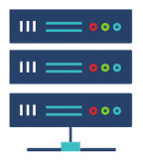
3 & 4
COLLECTING DATA AND SENDING IT TO THE SERVER
SERVER
DATA
ROOM DATABASE
SERVER DATABASE

Slide 14



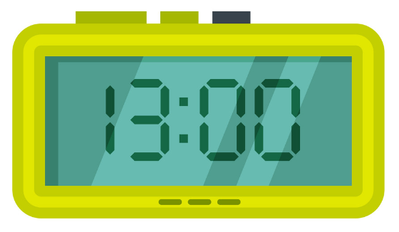
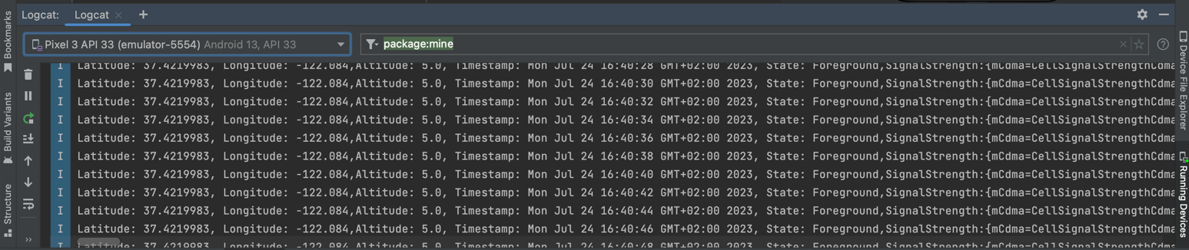
3 & 4
FILE FORMAT
DATA : GPS, NETWORK QUALITY, TIMESTAMP
EXAMPLE :

Slide 15
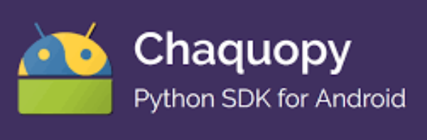
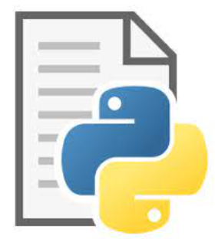

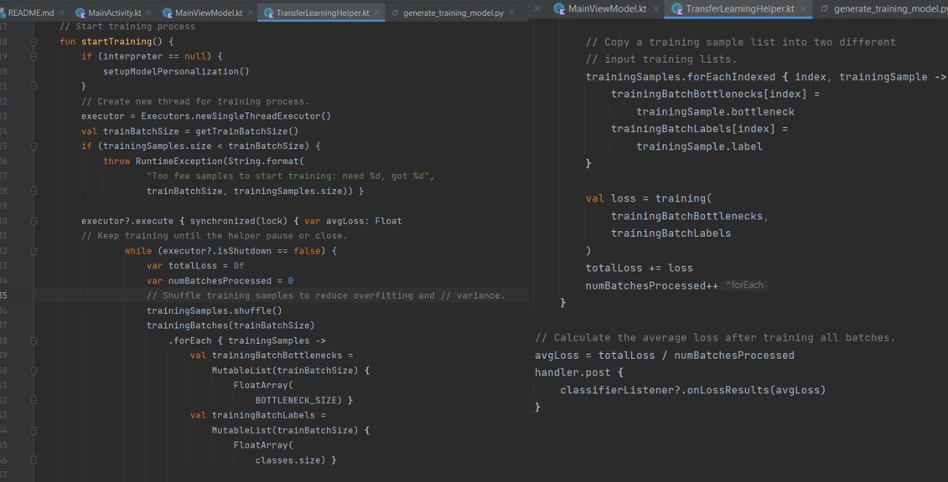
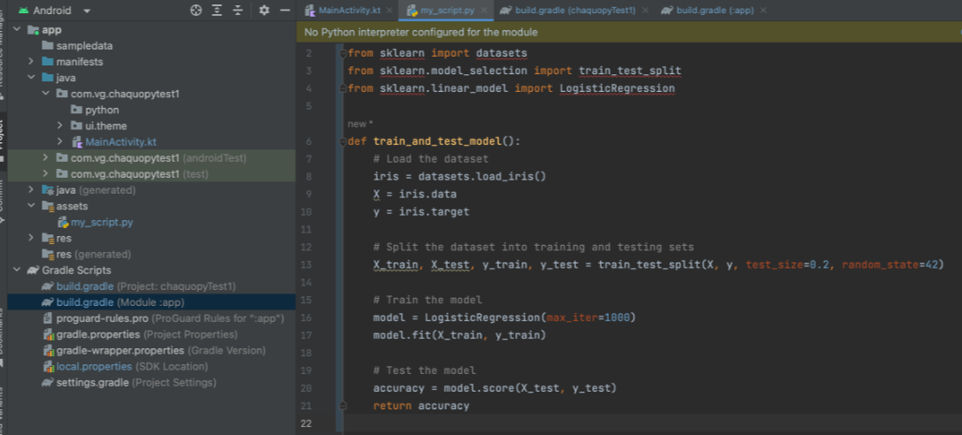


5
TRAINING THE DATA LOCALLY

Slide 16
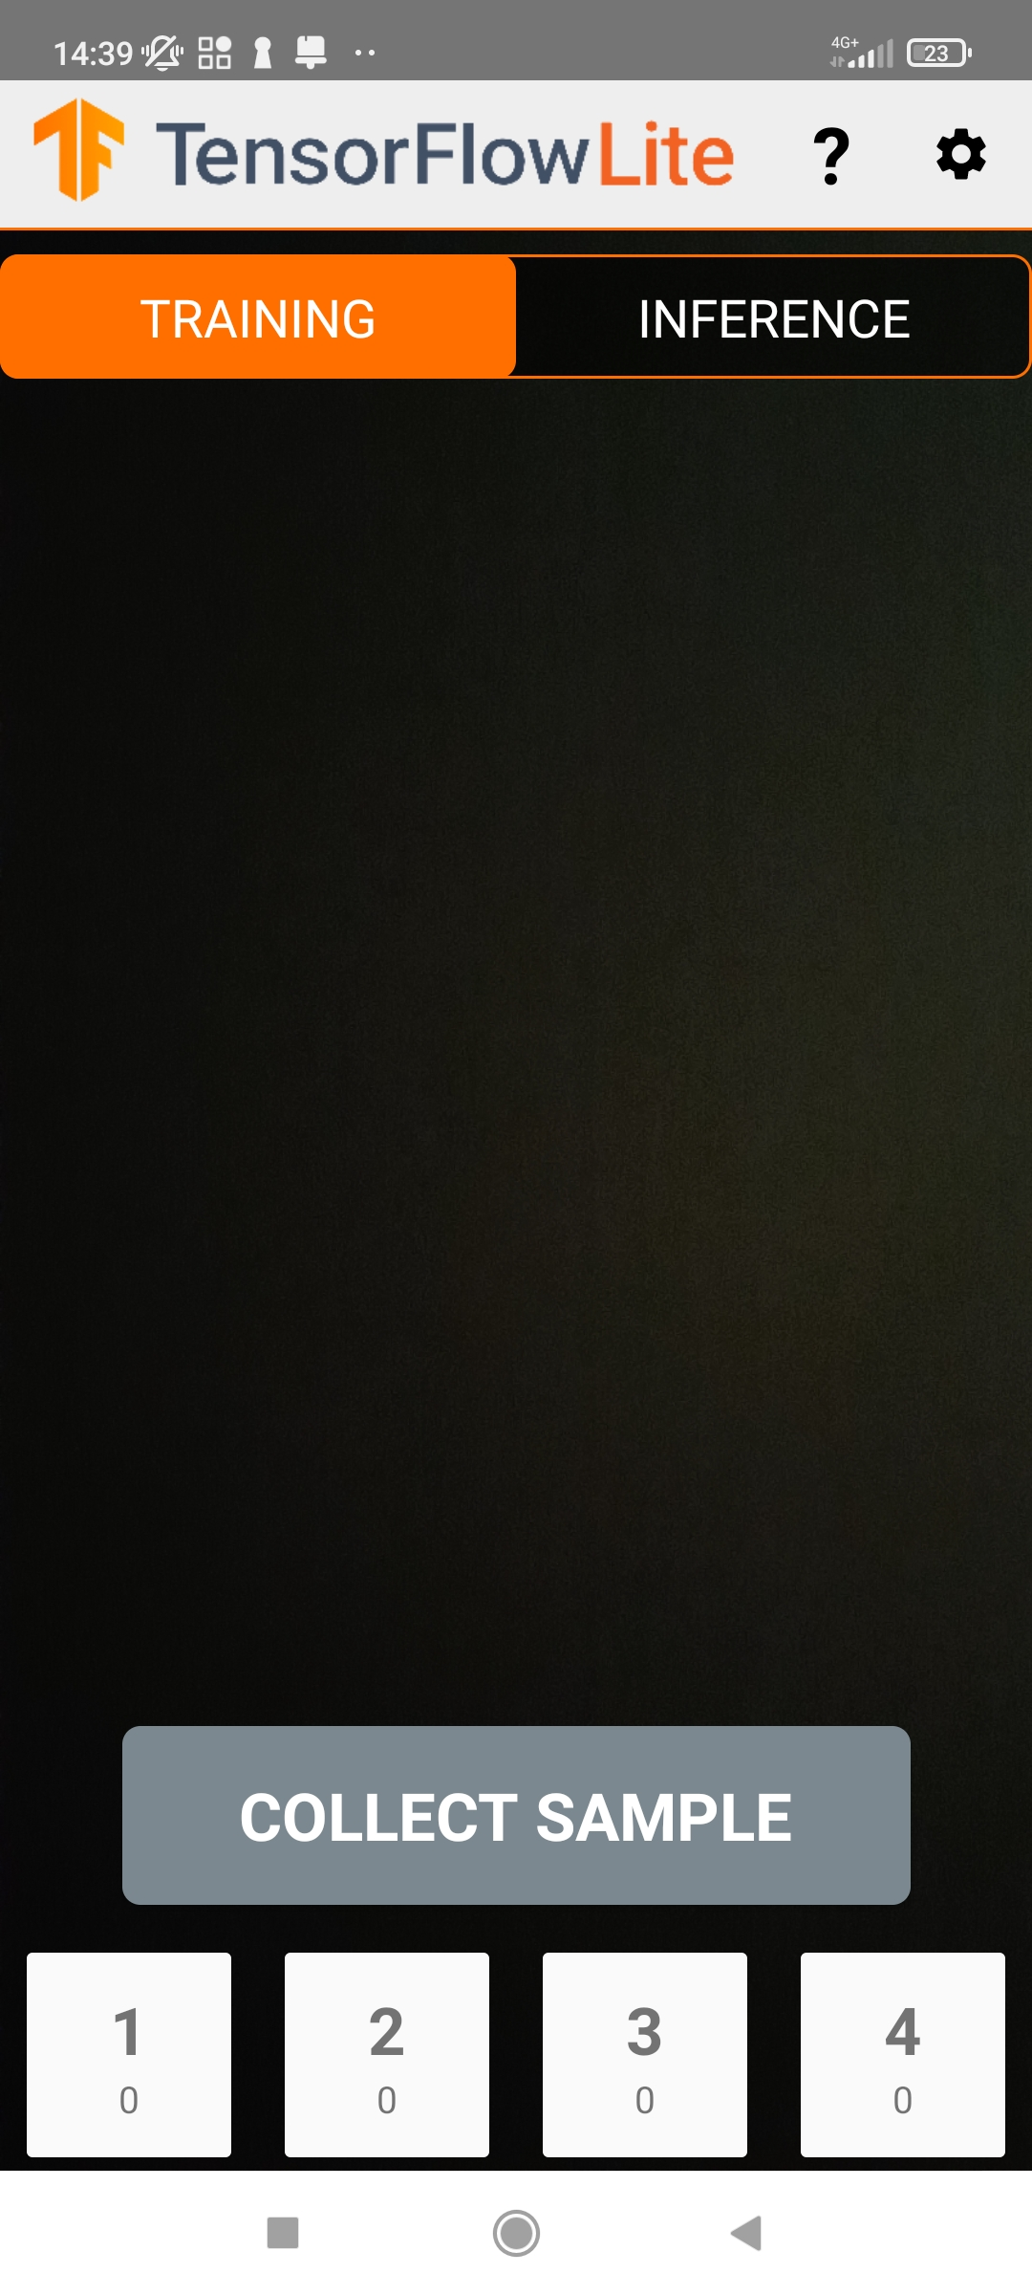
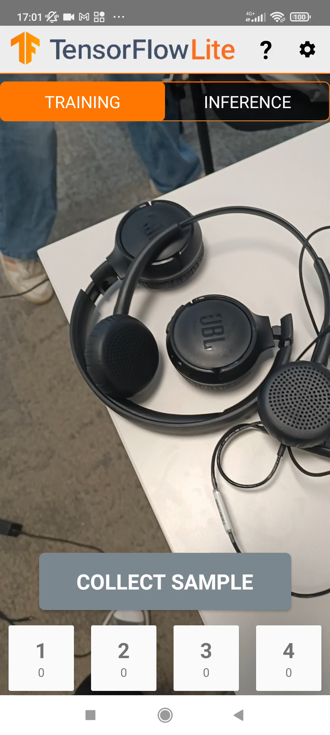
On device training

Slide 17
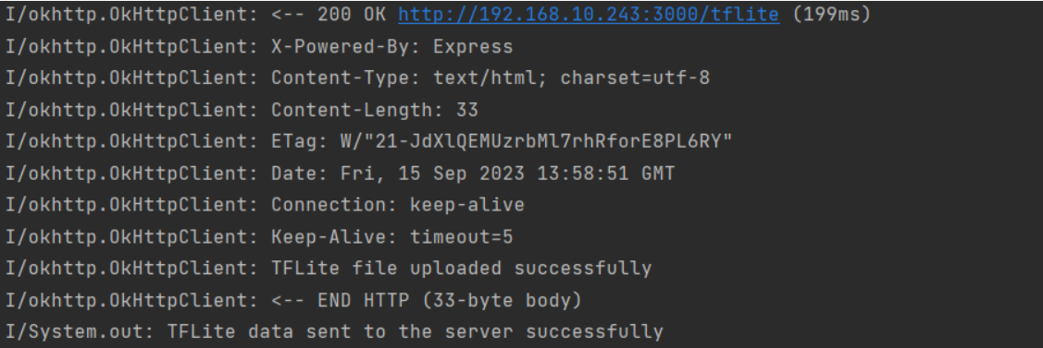
6
SENDING AND RECEIVING THE MODEL TO THE SERVER

Slide 18
PROJECT OVERVIEW

Slide 19
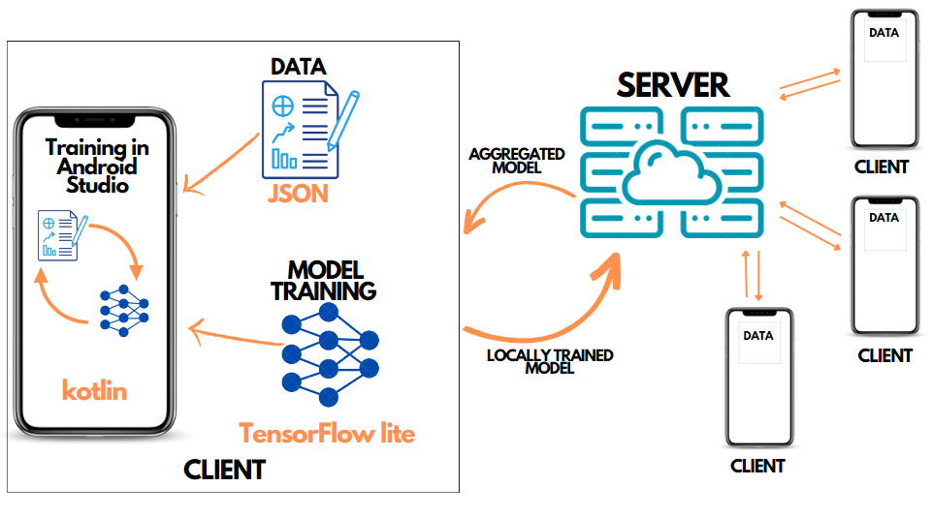

Slide 20
DEMO

Slide 21

Future improvements
On-device training :
Tensor flow lite (using appropriate time series algo for network data)
Server Architecture :
Aggregation of all the models

Slide 22
THANK YOU

Slide 23
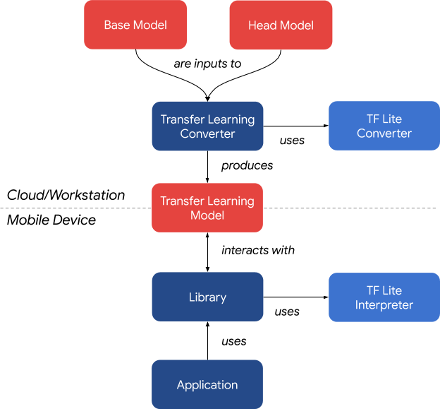
TENSORFLOW LITE IN ANDROID STUDIO

Slide 24
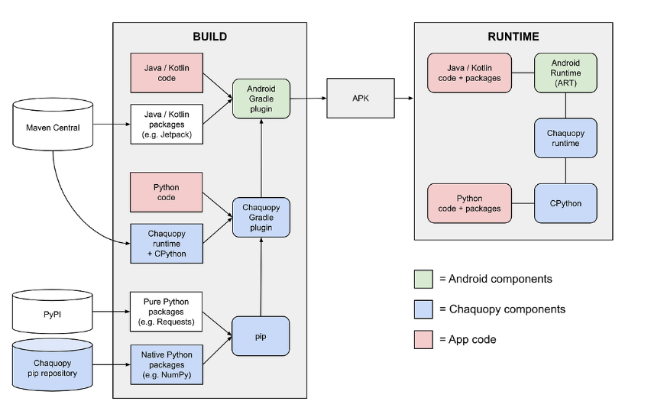
CHAQUOPY IN ANDROID STUDIO

